Slide 1
Automated Guided Vehicle (AGV)
Robotic Hardware Systems

Slide 2
Content
Definition
History
Physical Design for various applications
Locomotion System & Actuators
Navigation System (Sensors) & Control
Data Collection
Data transmission
Power Management

Slide 3
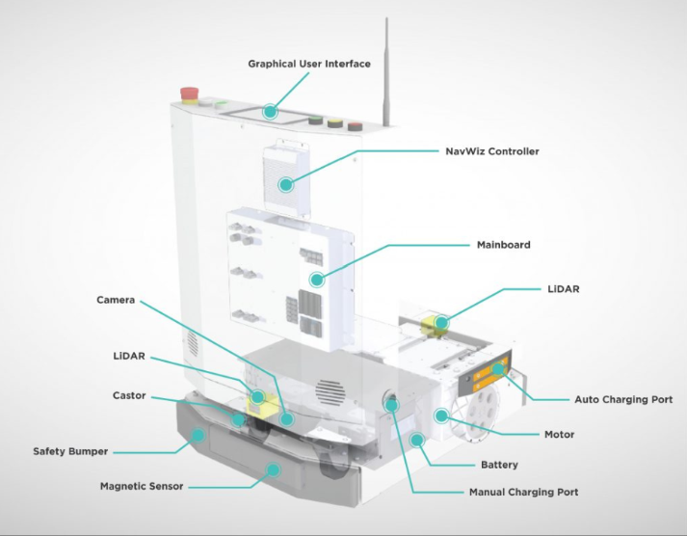
Definition
An automated guided vehicle (AGV) is a type of wheeled robot that does not require human presence. According to the instructions provided by a surveillance system, AGVs are able to get to a given point by a specified path using automatic guidance devices and on-board servers as well as to perform the tasks assigned to them. Due to their advantages in terms of agility and intelligence, VGAs are mainly used in flexible manufacturing systems and smart warehouses.
Today, their applications have been expanded and they are no longer limited to the industrial sector. They are also used in hospitals, museums, airports, etc.

Slide 4
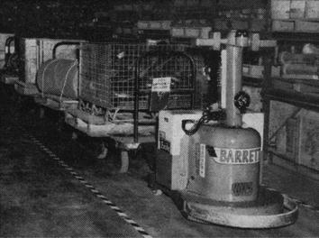
History
The first AGV was brought to market in the 1950s, by Barrett Electronics of Northbrook, Illinois, and at the time it was simply a tow truck that followed a wire in the floor instead of a rail
Over the years the technology has become more sophisticated and today automated vehicles are mainly Laser navigated e.g. LGV (Laser Guided Vehicle).
Today, the AGV plays an important role in the design of new factories and warehouses, safely moving goods to their rightful destination.

Slide 5
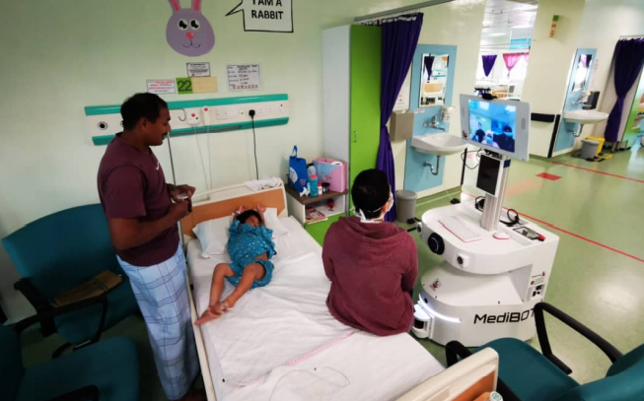
Physical Design for various applications
MediBOT
Used to safely navigate in health care facilities
Equipped by a user interface that meets doctor and nurse requirements
UVC light box, wireless, device tools, Auto hand sanitizer
PTZ camera LED
Depth tracking camera
Industrial PC robot navigation and QR code localization

Slide 6
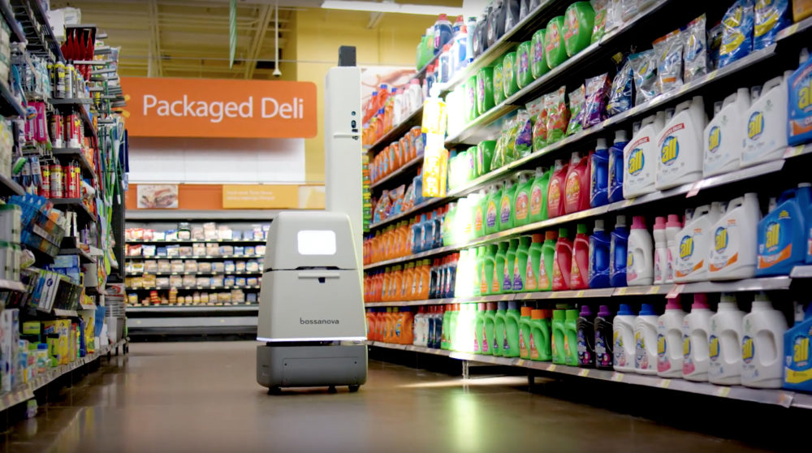
Physical Design for various applications
Bossa Nova
designed to operate in large to medium format brick-and-mortar retail locations
Scan the shelves and deliver data such as “Out-of-stocks, on-shelf items requiring correction, missed price changes, and missing flag tags”

Slide 7
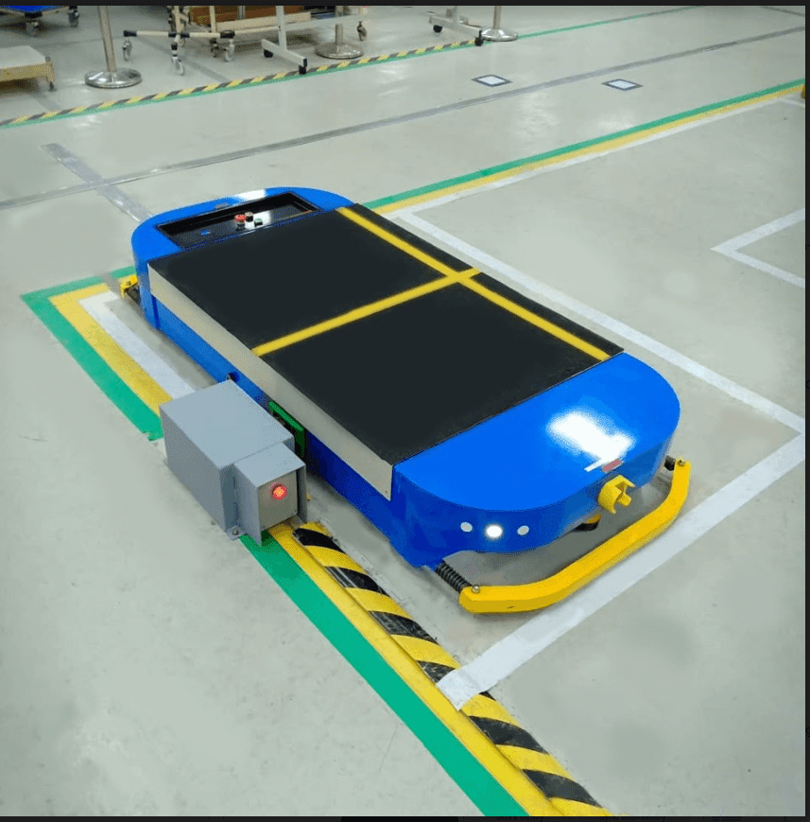
Physical Design for various applications
Ideasparq M_AGV
Front sensor to prevent collision
Battery level Indicator
LCD Screen for work progress
Light Indicator for machine errors
Sound Indicator for obstacles detection
Emergency Button

Slide 8
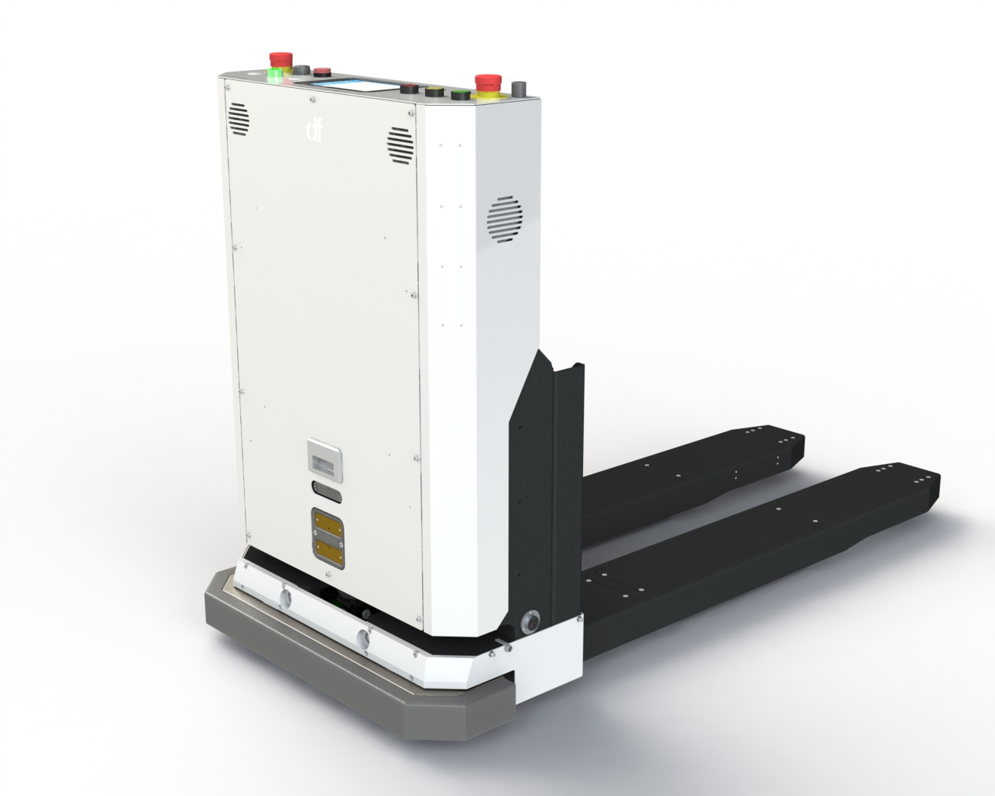
Physical Design for various applications
Zetha series (by df automation)
2-wheel differential drive
Emergency switch
Safety laser scanner
3D camera
Ultrasonic Sensors
Bumpers
RGB LED lighting
Touchscreen
RFID, Limit sensor

Slide 9
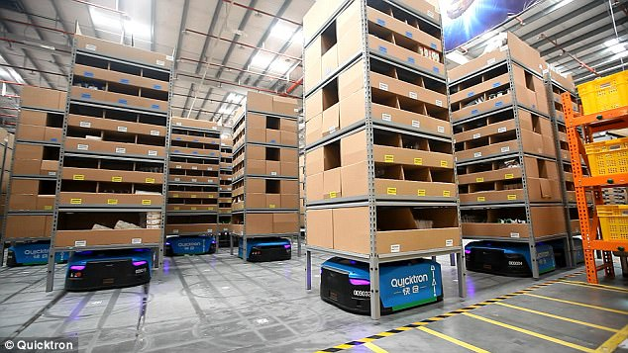
Physical Design for various applications
Quicktron
Visual 2D code + inertial navigation
LIDAR obstacle avoidance
WIFI communication
Used to carry shelves, deliver, and arrange them properly

Slide 10
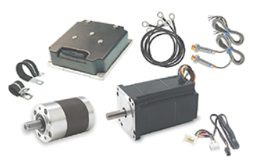
Locomotion System & Actuators
The motion module of a AGV consists of motors, motor control units, and drive circuits.
Vehicle speed is calculated by processor. The direction of vehicles varies when the motors on either side are rotating at different speeds.
While in motion, the AGV relies on an ultrasonic or infrared sensor to detect obstacles in its path.
Accelerometer is used to detect the inclination of the ground in order to prevent the falling of the transported products. The AGV load/unload module is used to load and unload products by controlling a motor driving a fork.
The Allied Motion EPS steering motor actuator

Slide 11
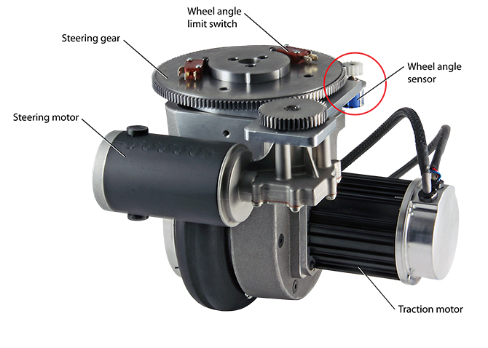
Locomotion System & Actuators
The AGV is powered by a battery. If the power goes low, the control system orders the vehicle to drive to a specific location to be automatically recharged.
With developments in sensor technology, it should be possible to combine multiple navigation and obstacle detection methods to make AGVs smarter and more accurate.

Slide 12
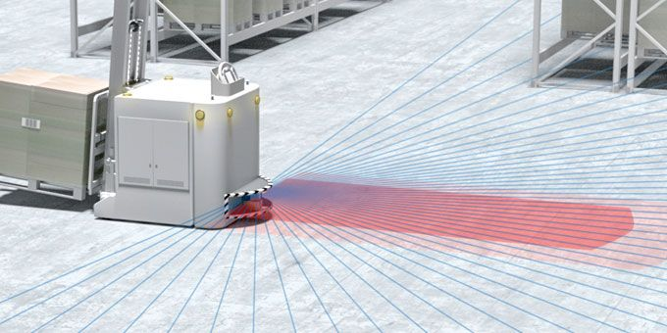
Navigation System (Sensors) & Control
Navigation is certainly the key function of AGVs
Navigation methods currently adopted in AGVs include navigation by: Electromagnetic, magnetic stripe, optical, infrared, laser and visual.
Laser navigation is a popular method used for AGVs due to the great agility and precise control it provides.
The implementation of a laser navigation requires the fixing on the walls and obstacles of a large number of rectangular prisms reflecting the light towards the vehicles, as well as that of transceivers which can rotate horizontally at the top of the vehicles.
Navigation and safety monitoring of the transportation path with the RSL 400 safety laser scanner

Slide 13
Data Collection and Transmission
Data is collected by sensors and cameras mostly and transmitted by GPS, Wi-Fi, Bluetooth or electrically to an indicator.
The sensors will sense a various type of environment, such as a line to be followed or obstacles for navigation, bar codes or equipment on shelves for arranging purposes.
In navigation, a LiDAR sensor transmits a collection of laser pulses that measure the range between objects and the vehicle itself. This compiled data creates a full 360° environmental map of the operational area, and the subsequent mapping enables the AGV to navigate throughout the facility without any additional infrastructure.
The information read by the sensors will be then either sent to the human user or directly to the robot if it has a program ready to deal with the situation

Slide 14
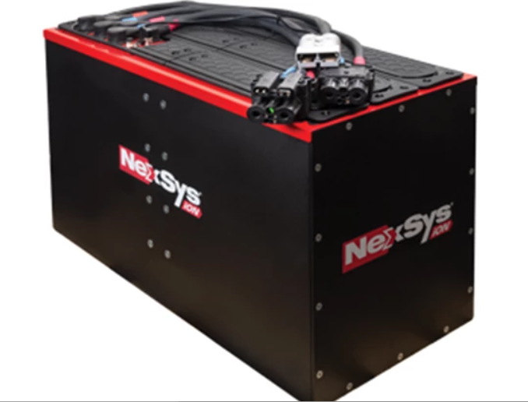
Power Management
Power is crucial to keep an automated guided vehicle (AGV) moving.
The types of batteries are chosen based on the AGV applications and equipment
NexSys® ion—Lithium-ion solution for the most demanding applications that require the highest energy throughput and charging flexibility

Slide 15
AGVs in the Market
According to Assembly Magazine, the average cost of an AGV can range anywhere between $100,000 to $150,000
AGV cost depends on the vehicle type , starting from $14.000 for an AGC, near $30.000 for a towing tractor, $60.000 for an automated pallet jack, around $80.000 for a forklift AGV and $150.000 for an automated VNA.

Slide 16
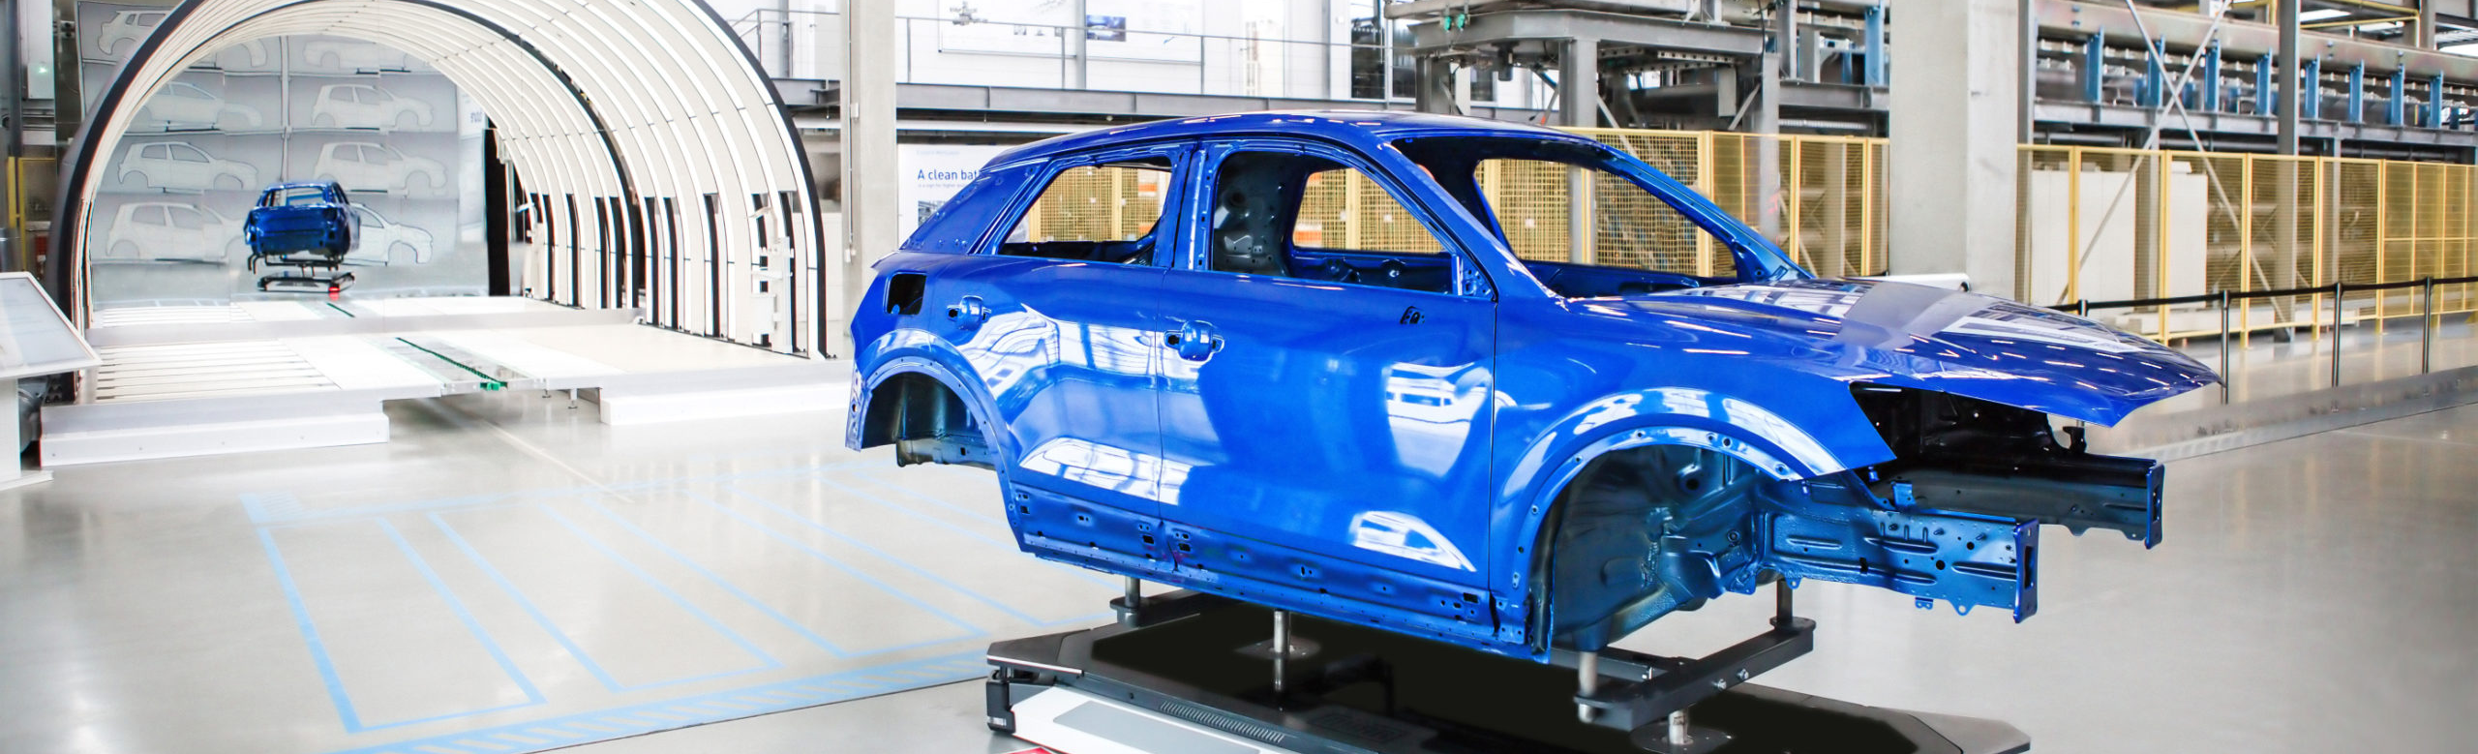
AGV in the future
With the AI growing, AGV will definitely see itself developing.
Engineers will develop and innovate new types of AGVs for new applications.
With the 5G, the communication, localization, and navigation systems of AGVs will be more efficient and precise.

